Slide 1
Banking management system
PROJECT BY
B.BHAVANI

Slide 2
INTRODUCTION
The Banking Management System is an Online application for an Organization. It has been developed on java. It is a virtual showcase for managing different types of withdrawal, deposit, loan. Two types of documents are required to open a new account, they are proof of identity and proof of address. Proof of Address Examples – Aadhar card, Voter ID, Ration card, Utility bill (electricity, telephone, gas, water), Driving license, Passport, Bank account statement or passbook of the bank.

Slide 3
PROJECT OBJECTIVE
The main objective of the Bank Application is to manage the details of Saving Account, Employees, Customer, Accounts, Current Account. It manages all the information about Saving Account, Fixed Deposit, Current Account, Saving Account. The project is totally built at administrative end and thus only the administrator is guaranteed the access.

Slide 4
BENIFITS OF BANKING APPLICATION
The benefits of developing a mobile banking application are as follows Availability 24×7 – Clients can perform their usual banking operations anytime and anywhere compared with traditional banks and ATMs. Variety Of Services & Functions – Top banking apps allow users to carry out almost all banking operations.
It helps Simply And Streamlines All Task.
Accurate information is available.

Slide 5
SOME BASIC CONCEPTS
Switch: switch statement executes one statement based on the user requirement form multiple conditions.
If-else: If the condition true then only executes if the block otherwise it executes else block.
Do-while: It is used to iterate a part of the program repeatedly, until the specified condition is true. This do-while loop to execute the loop at least once.

Slide 6
Scanner
In java Scanner class used to read the input from the keyboard.
Scanner class is available java.util.package
To read console input we have to construct a Scanner object.
Scanner s= new Scanner(System.in);
Scanner class have some methods like next(),nextInt().
In this project by using Scanner class I use to read user name, account number,…etc.

Slide 7
boolean
In Java, the boolean keyword is a primitive data type.
It is used to store only two possible values, either true or false.
It specifies 1-bit of information and its "size" can't be defined precisely.
The boolean keyword is used with variables and methods.

Slide 8
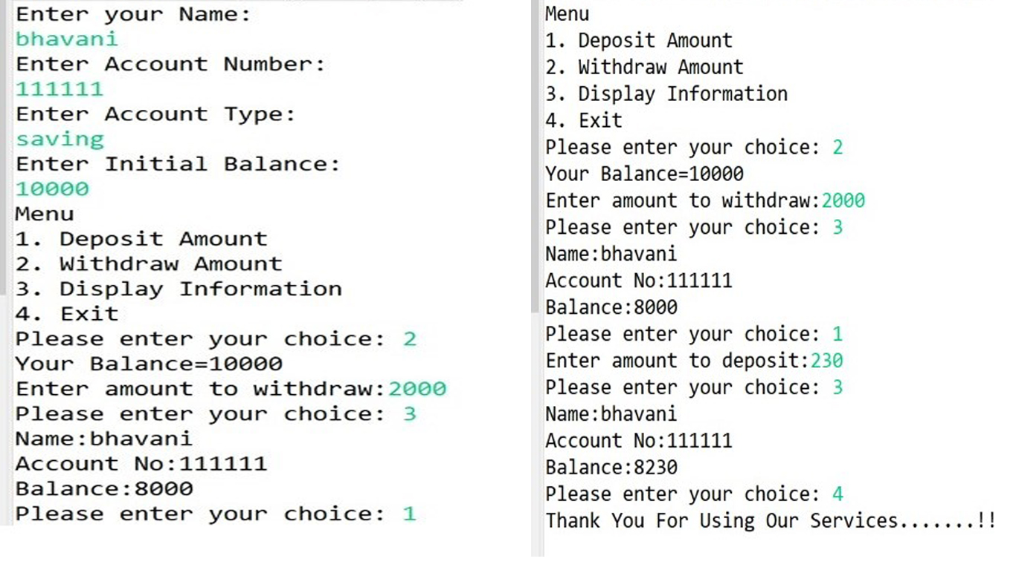
output

Slide 9
THANK YOU..

